Slide 1
A gesture based tool for sterile browsing of radiology images cnn and open cv

Slide 2
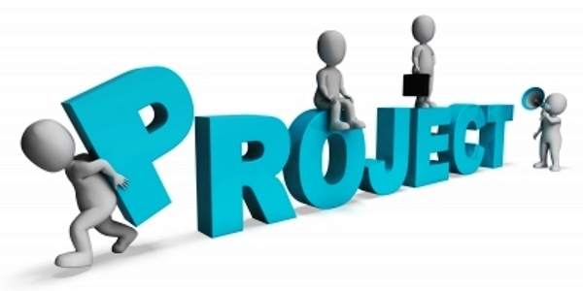
TEAM: IT_AIML_A11
18481A1249 - SAI TRIVENI KOTTAPALLI
18481A1243 - Naga venkata sai harshith
18481A1202 - Supraja Abburi
18481A1216 - Bade Jaswanth

Slide 3
INTRODUCTION
Humans are able to recognize body and sign language easily. This is possible due to the combination of vision and synaptic interactions that were formed along brain development.
In this project Gesture based Desktop automation, First the model is trained pre trained on the imahes of different hand gestures, such as showing numbers with fingers as 1,2,3,4.
This model uses the integrated webcam to capture the video frame. The image of the gesture captured in the video frame is compared with the pre trained model and the gesture is identified.
If the gesture predicts is 1 then images is blurred; 2 then image is resized; 3 then images is rotated etc

Slide 4
PROJECT OBJECTIVES
Know
Know fundamental concepts and techniques of Convolutional Neural Network (CNN)
Gain
Gain a broad understanding of image data.
Know
Know how to pre-process/clean the data using different data pre-processing techniques.
Know
Know how to build a web application using Flask framework.

Slide 5
In this we will be improving the data that supresses unwilling distortions or enhances some image features important for further processing, although perform some geometric transformations of images like rotation, scaling, translation etc.
Image
Pre -
processing

Slide 6

Import the image data generator library
Image data augmentation is a technique that can be used t artificially expand the size of a training dataset by creating modified versions of images in the dataset.
The keras deep learning neural network library provides the capability to fit models using image data augmentation via the ImageDataGenerator class

Slide 7
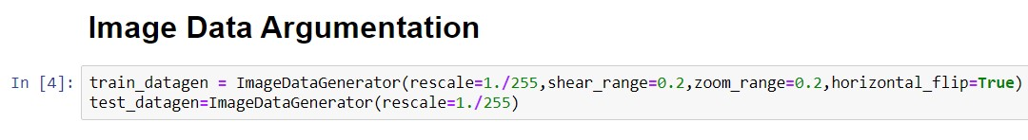
Configure image data generator class
Image Data Generator class is instantiated and the configuration for the types of data augmentation
There are five main types of data augmentation techniques
Image shifts via the width _shift _ range and height _shift _ range arguments
Image flips via the horizontal _ flip and vertical _ flip arguments
Image rotations via the rotation _ range arguments
Image brightness via the brightness _ range arguments
Image zoom via the zoom _ range argument

Slide 8
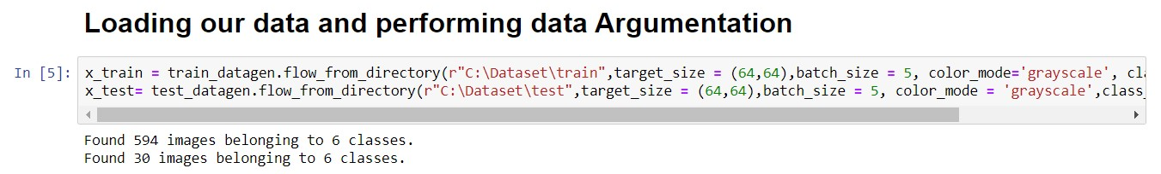
Applying image data generator functionality to trainset and to testset
This function will return batches of images from the subdirectories 0,1,2,3,4,5 together with labels 0 to 5 {‘0’ : 0, ‘1’ : 1, ‘2’ : 2, ‘3’ : 3, ‘4’ : 4, ‘5’ : 5 }

Slide 9
Time to build our Convolutional Neural Networking which contains a input layer along with convolution, maxpooling and finally an output layer
MODEL BUILDING

Slide 10
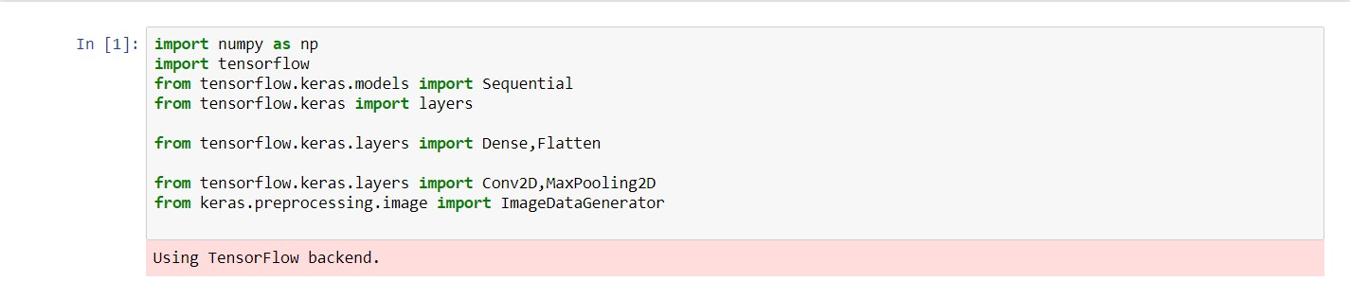
Importing the model building libraries

Slide 11

Initializing the model
Sequential model is a linear stack of layers.
You can create a sequential model by passing a list of layer instances to the constructor from keras models import Sequential from keras

Slide 12
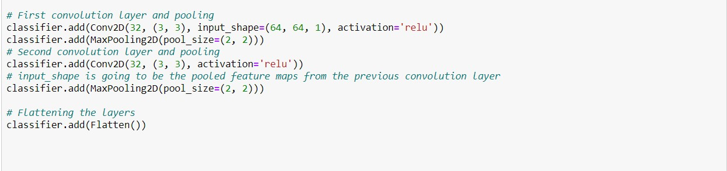
Adding Cnn layers
We are adding a convolution layer with activation function as “relu” and with a small filter size (3,3) and number of filters (32) followed by a max pooling layer
Maxpool layer is used to downsample the input
Flatten layer flattens the output

Slide 13
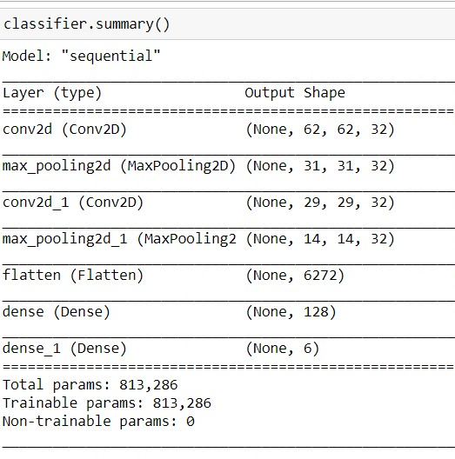

Adding dense layers
Dense layer is deeply connected neural network layer. It is most common and frequently used layer.
Understanding the model is very important phase to properly use it for training and prediction purposes.
Keras provides a simple method, summary to get the full information about the models and its layers.

Slide 14
Configure the learning process
The compilation is the final step in creating the model. Once the compilation is done, we can move on to the training process.
Optimization is an important process which optimize the input weights by comparing the prediction and the loss function
Metrics is used to evaluate the performance of your model. It is similar to loss function, but not used in training process

Slide 15

Train the model
Fit_generator functions are used to train a deep learning neural network
Arguments
Steps_per_epoch : It specifies the total number of steps taken from the generator as soon as one epoch is finished and next epoch has started.
Epochs : an integer and number of epochs we want to train our model for
Validation_data can be either
An inputs and targets list
A generator
An inputs, targets and sample_weights list which can be used to evaluate the loss and metrics for any model after any epoch has ended.

Slide 16
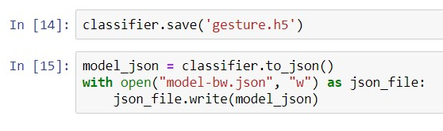
Save the model
The model is saved with .h5 extension.
An H5 file is a data file saved in the Hierarchical Data Format (HDF)
It contains multidimensional arrays of scientific data

Slide 17
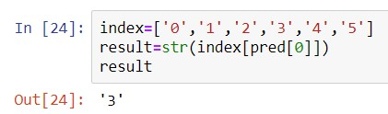
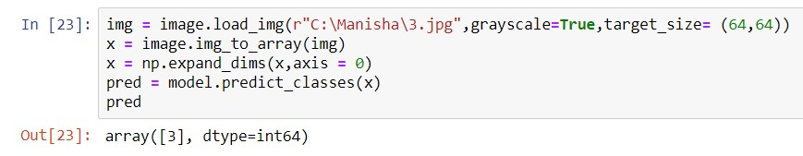

Test the model
Evaluation is a process during development of the model to check whether the model is best fir for the given problem and corresponding data

Slide 18
After the model is trained in this particular milestone, we will be building our flask application which will be running in out local browser with a user interface
Application building

Slide 19
Create HTML pages
We use HTML to create the front end part of the web page
Here, we created 3 HTML pages – home.html, intro.html and index6.html
Home.html displays the home page
Intro.html displays the introduction about the hand gesture recognition
Index6.html accepts the input from the user and predicts the values.
We also use JavaScript-main.js and CSS-main.css to enhance our functionality and view of HTML pages

Slide 20
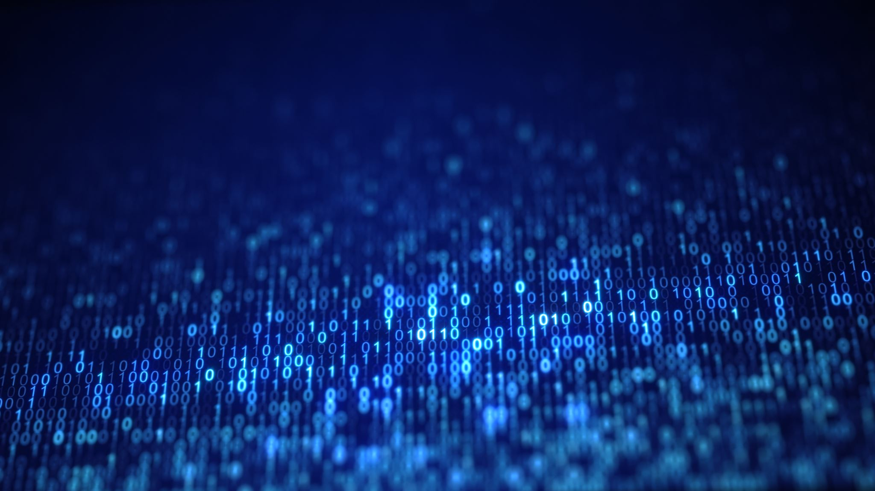
Build
Python
code

Slide 21
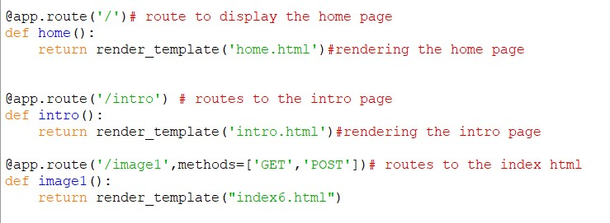
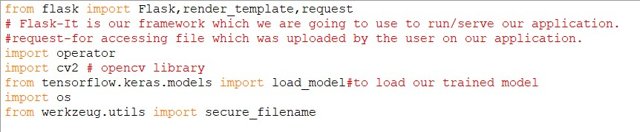
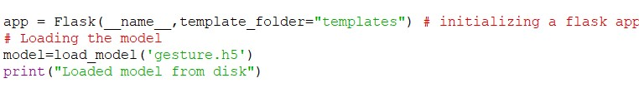
Code
Creating our flask applications and loading our model
Importing Libraries
Routing to the html page

Slide 22
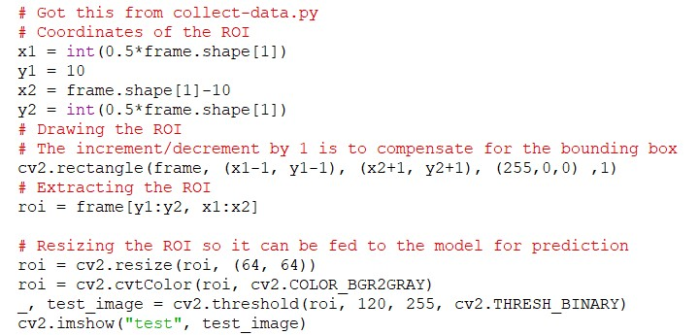
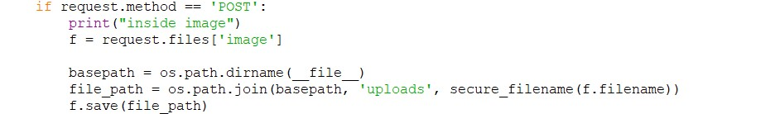
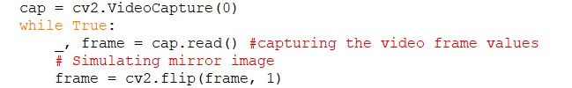
CODE
Getting our input and storing it
Creating ROI
Grab the frames from the web cam

Slide 23
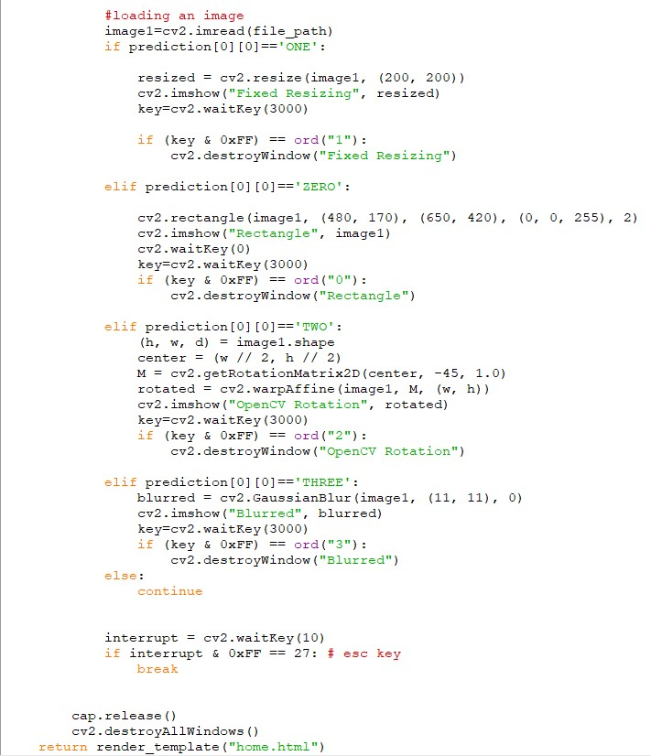
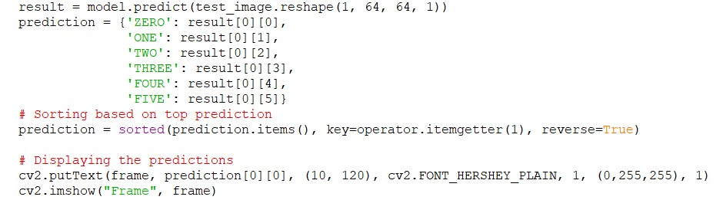
CODE Predicting our results

Slide 24
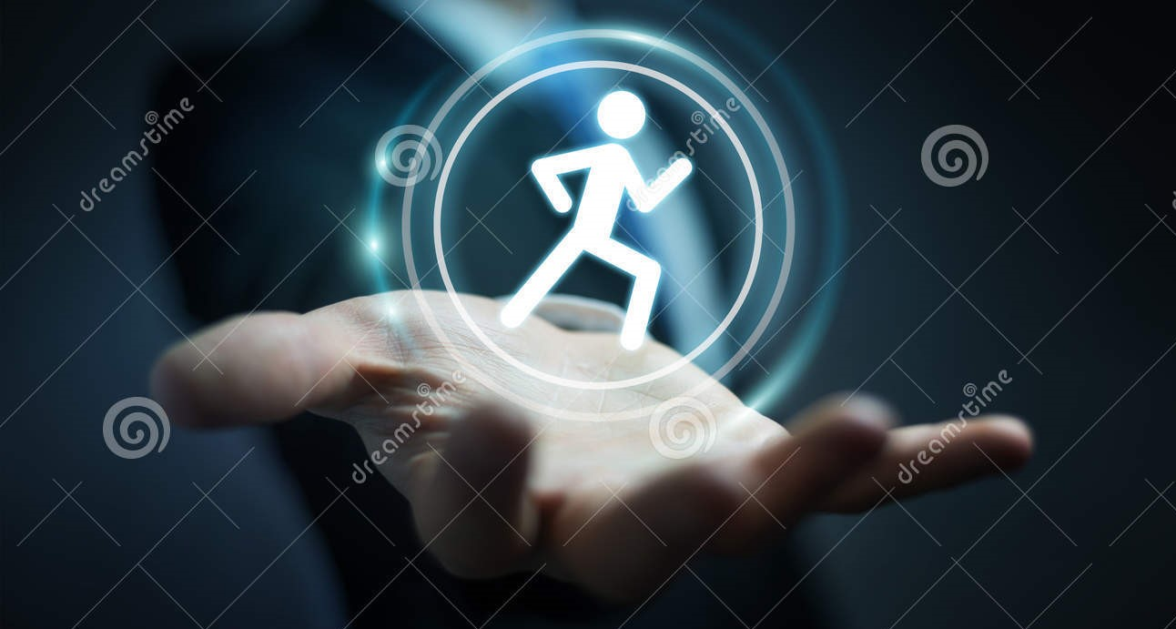
RUN THE APPLICATION

Slide 25

Home page

Slide 26
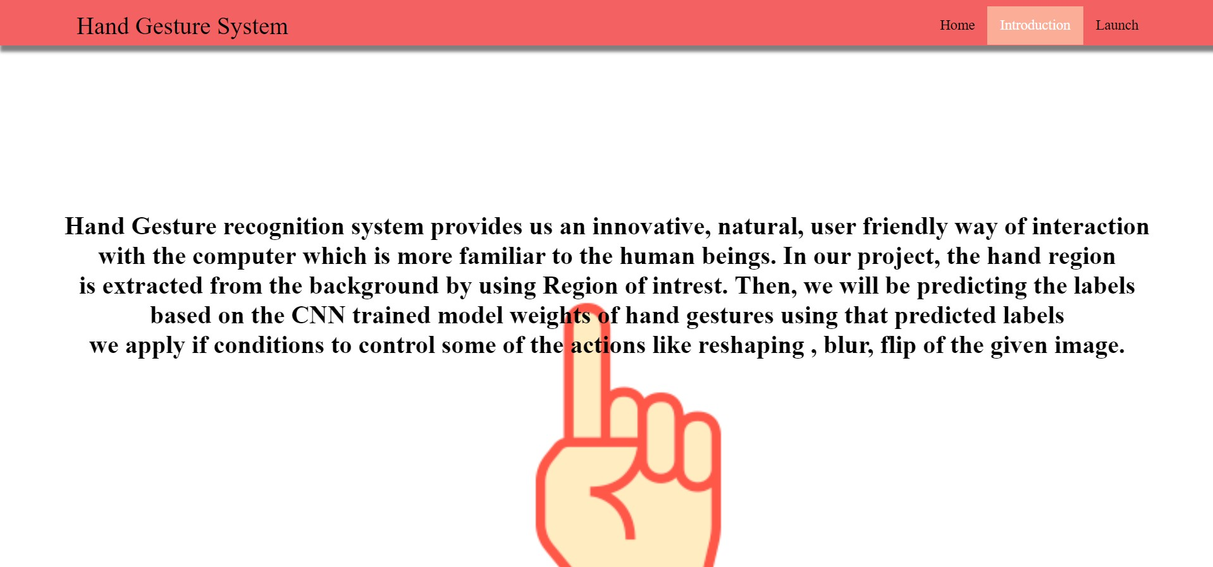
Introduction page

Slide 27
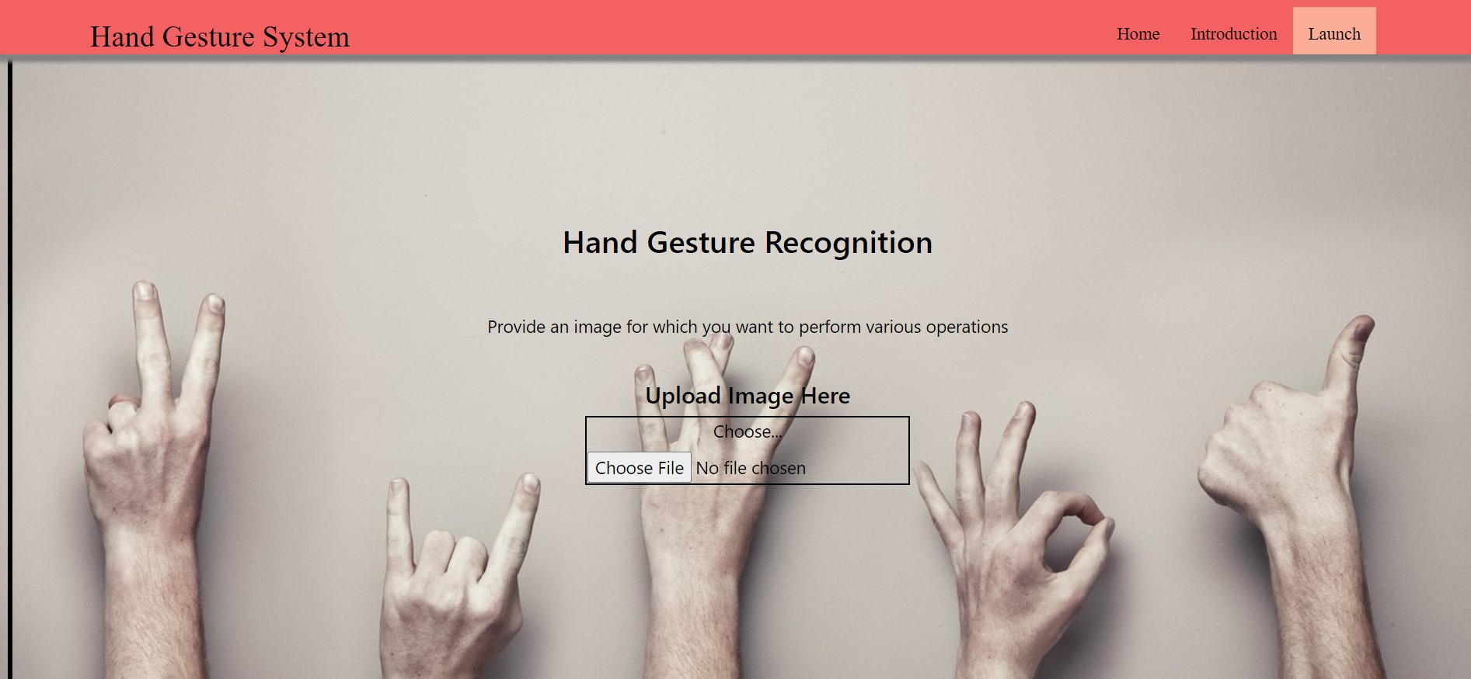
Prediction page

Slide 28


